Slide 1

Introduction to Probability and Statistics
Twelfth Edition
Robert J. Beaver • Barbara M. Beaver • William Mendenhall
Presentation designed and written by:
Barbara M. Beaver

Slide 2
Introduction to Probability and Statistics
Twelfth Edition
Chapter 12
Linear Regression and Correlation
Some graphic screen captures from Seeing Statistics ®
Some images © 2001-(current year) www.arttoday.com

Slide 3

Introduction
In Chapter 11, we used ANOVA to investigate the effect of various factor-level combinations (treatments) on a response x.
Our objective was to see whether the treatment means were different.
In Chapters 12 and 13, we investigate a response y which is affected by various independent variables, x_{i}.
Our objective is to use the information provided by the x_{i} to predict the value of y.

Slide 4
Example
Let y be a student’s college achievement, measured by his/her GPA. This might be a function of several variables:
  x₁ = rank in high school class
  x₂ = high school’s overall rating
  x₃ = high school GPA
  x₄ = SAT scores
We want to predict y using knowledge of x₁, x₂, x₃ and x₄.

Slide 5

Example
Let y be the monthly sales revenue for a company. This might be a function of several variables:
  x₁ = advertising expenditure
  x₂ = time of year
  x₃ = state of economy
  x₄ = size of inventory
We want to predict y using knowledge of x₁, x₂, x₃ and x₄.

Slide 6
Some Questions
Which of the independent variables are useful and which are not?
How could we create a prediction equation to allow us to predict y using knowledge of x₁, x₂, x₃ etc?
How good is this prediction?
We start with the simplest case, in which the response y is a function of a single independent variable, x.

Slide 7
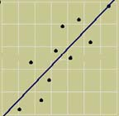
A Simple Linear Model
In Chapter 3, we used the equation of
a line to describe the relationship between y and x for a sample of n pairs, (x, y).
If we want to describe the relationship between y and x for the whole population, there are two models we can choose
Deterministic Model: y = α + βx
Probabilistic Model:
  y = deterministic model + random error
  y = α + βx + ε

Slide 8
A Simple Linear Model
Since the bivariate measurements that we observe do not generally fall exactly on a straight line, we choose to use:
Probabilistic Model:
  y = α + βx + ε
  E(y) = α + βx
Points deviate from the
line of means by an amount
ε where ε has a normal distribution with mean 0 and variance σ².

Slide 9
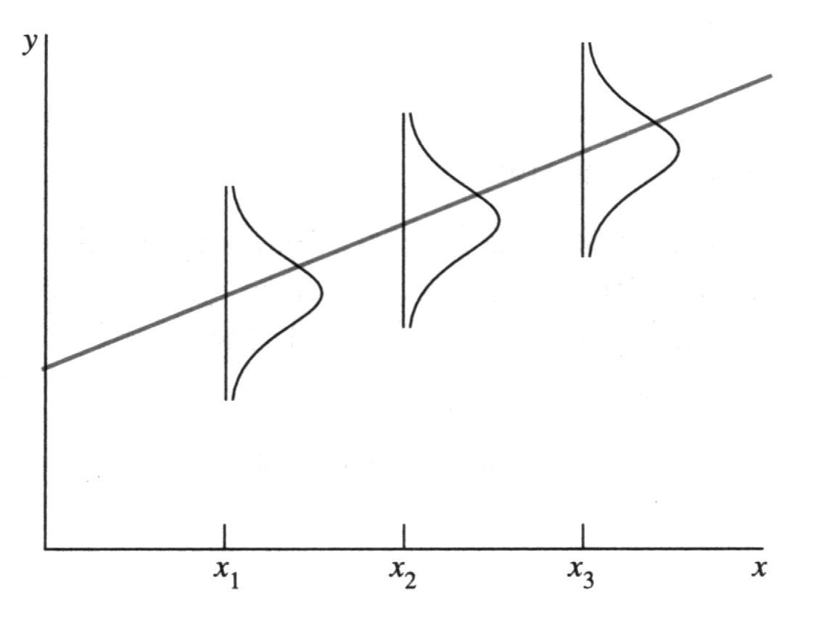
The Random Error
The line of means, E(y) = α + βx , describes average value of y for any fixed value of x.
The population of measurements is generated as y deviates from
the population line
by ε. We estimate α
and β using sample
information.

Slide 10
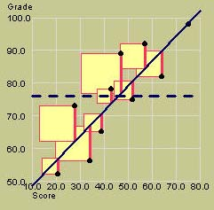
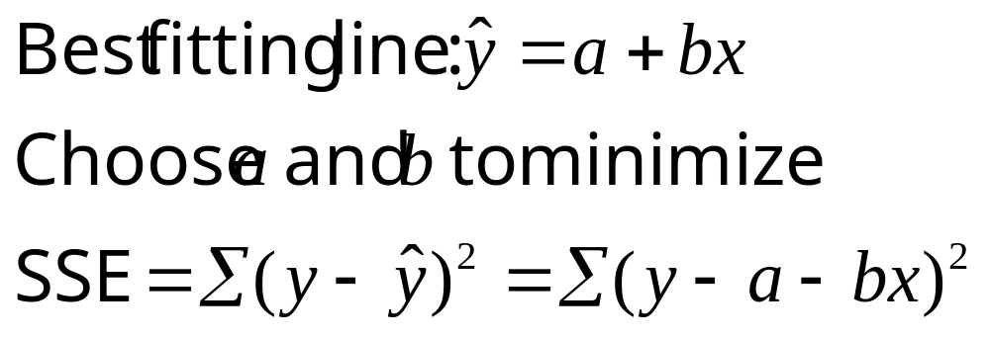
The Method of
Least Squares
MY
APPLET
The equation of the best-fitting line
is calculated using a set of n pairs (x_{i}, y_{i}).
We choose our estimates a and b to estimate α and β so that the vertical distances of the points from the line,
are minimized.

Slide 11
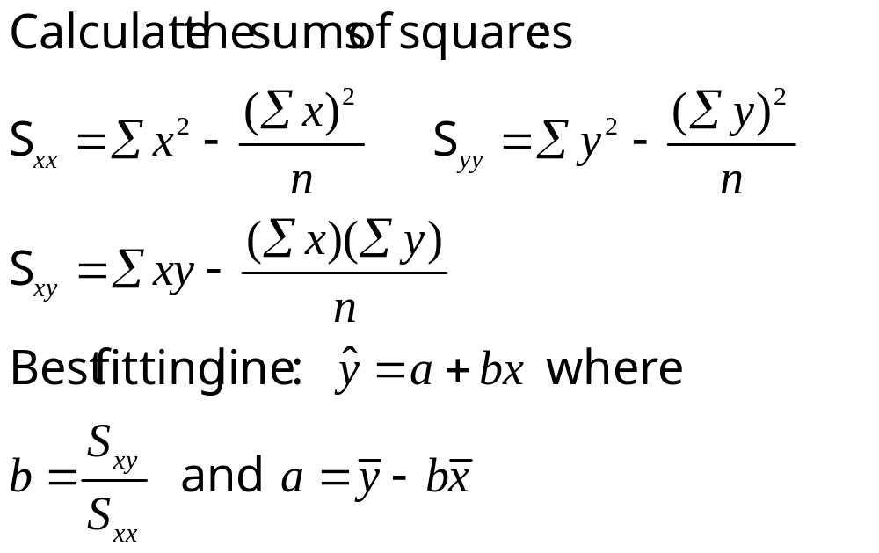
Least Squares Estimators

Slide 12
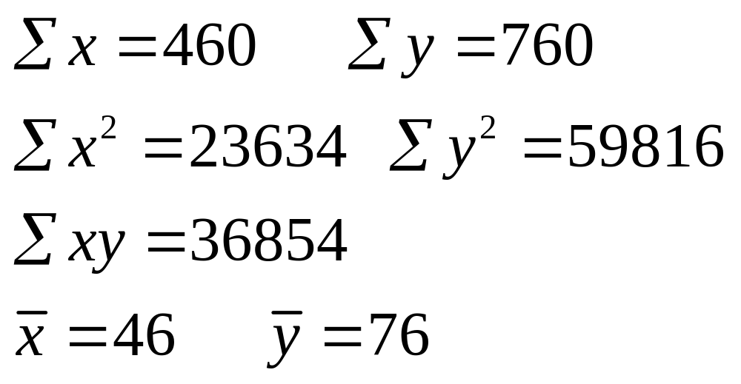
Example
The table shows the math achievement test scores for a random sample of n = 10 college freshmen, along with their final calculus grades.
Student | 1 | 2 | 3 | 4 | 5 | 6 | 7 | 8 | 9 | 10
Math test, x | 39 | 43 | 21 | 64 | 57 | 47 | 28 | 75 | 34 | 52
Calculus grade, y | 65 | 78 | 52 | 82 | 92 | 89 | 73 | 98 | 56 | 75
Use your calculator to find the sums and sums of squares.

Slide 13
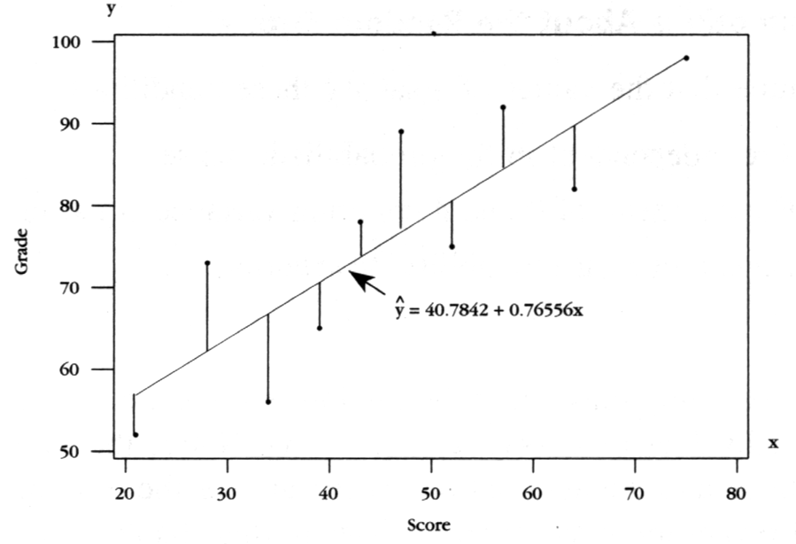
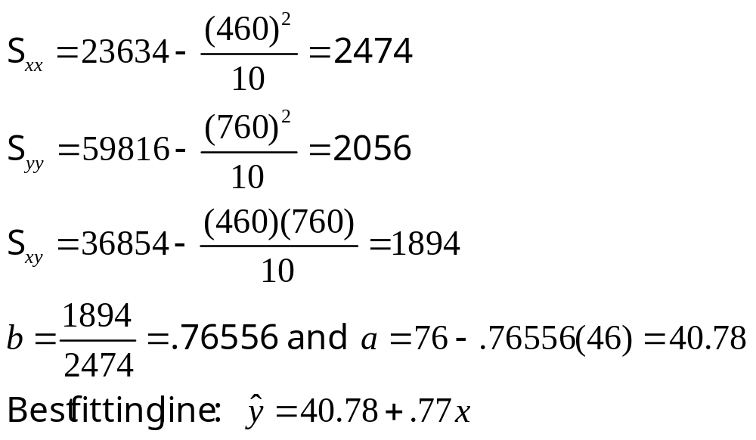
Example

Slide 14
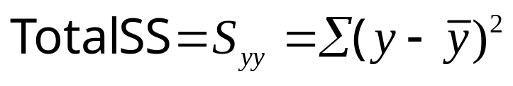
The Analysis of Variance
The total variation in the experiment is measured by the total sum of squares:
The Total SS is divided into two parts:
SSR (sum of squares for regression): measures the variation explained by using x in the model.
SSE (sum of squares for error): measures the leftover variation not explained by x.

Slide 15
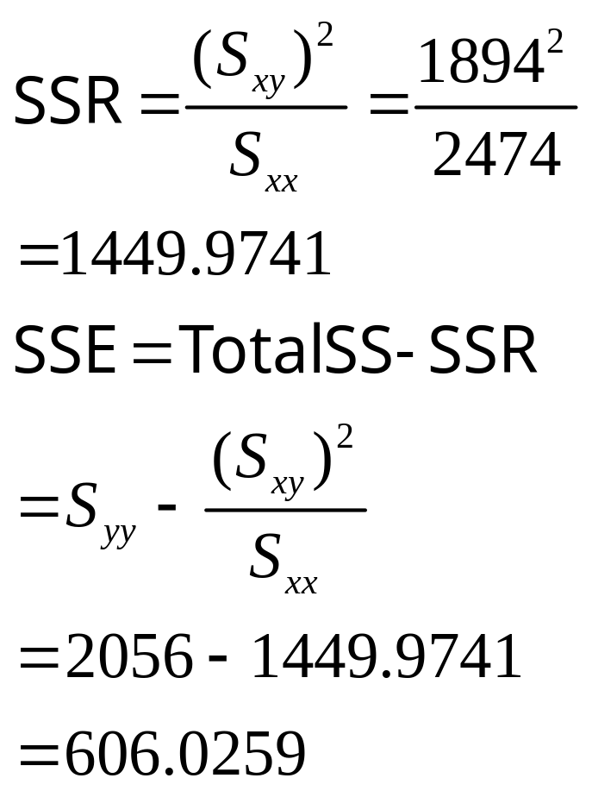
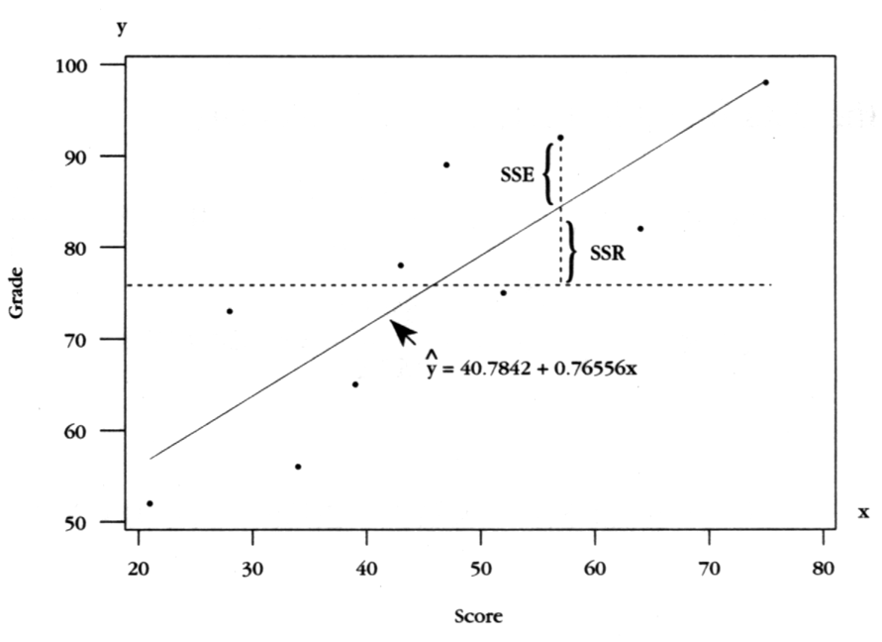
The Analysis of Variance
We calculate

Slide 16
The ANOVA Table
Total df = Mean Squares
Regression df =
Error df =
n -1
1
MSR = SSR/(1)
n –1 – 1 = n - 2
MSE = SSE/(n-2)
Source | df | SS | MS | F
Regression | 1 | SSR | SSR/(1) | MSR/MSE
Error | n - 2 | SSE | SSE/(n-2)
Total | n -1 | Total SS

Slide 17
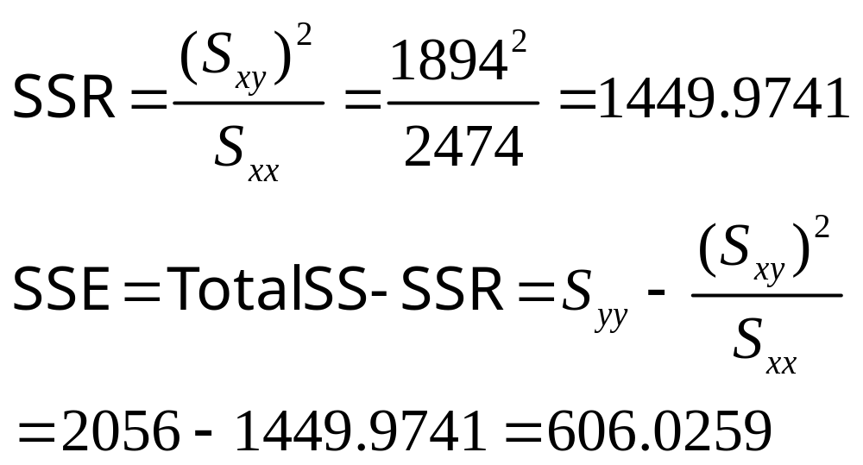
The Calculus Problem
Source | df | SS | MS | F
Regression | 1 | 1449.9741 | 1449.9741 | 19.14
Error | 8 | 606.0259 | 75.7532
Total | 9 | 2056.0000

Slide 18
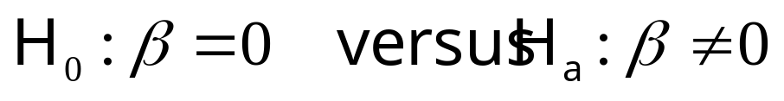
Testing the Usefulness of the Model
The first question to ask is whether the independent variable x is of any use in predicting y.
If it is not, then the value of y does not change, regardless of the value of x. This implies that the slope of the line, β, is zero.

Slide 19
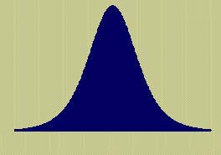
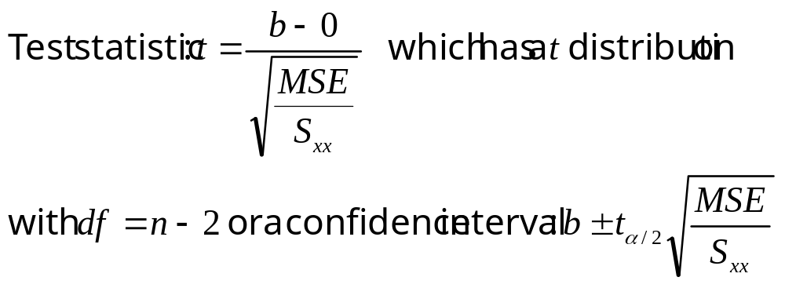
Testing the
Usefulness of the Model
The test statistic is function of b, our best estimate of β. Using MSE as the best estimate of the random variation σ², we obtain a t statistic.

Slide 20
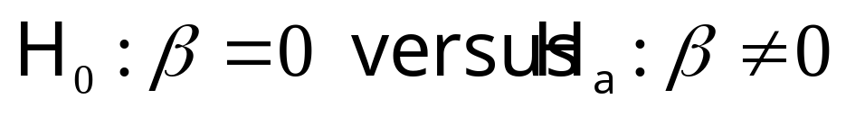
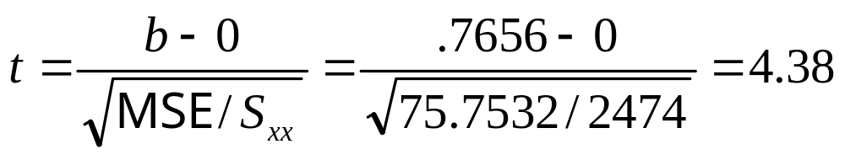
The Calculus Problem
MY
APPLET
  Is there a significant relationship between the calculus grades and the test scores at the 5% level of significance?
There is a significant linear relationship between the calculus grades and the test scores for the population of college freshmen.
Reject H ₀ when |t| > 2.306. Since t = 4.38 falls into the rejection region, H ₀ is rejected .

Slide 21
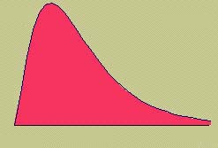
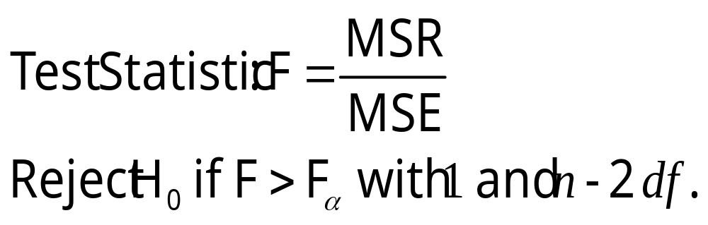
The F Test
You can test the overall usefulness of the model using an F test. If the model is useful, MSR will be large compared to the unexplained variation, MSE.
This test is exactly equivalent to the t-test, with t² = F.

Slide 22
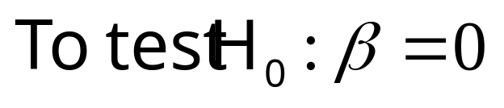
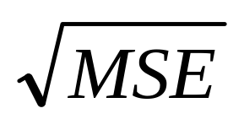
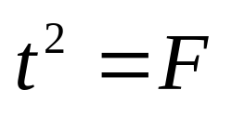
Minitab Output
Least squares regression line
Regression Analysis: y versus x
The regression equation is y = 40.8 + 0.766 x
Predictor Coef SE Coef T P
Constant 40.784 8.507 4.79 0.001
x 0.7656 0.1750 4.38 0.002
S = 8.70363 R-Sq = 70.5% R-Sq(adj) = 66.8%
Analysis of Variance
Source DF SS MS F P
Regression 1 1450.0 1450.0 19.14 0.002
Residual Error 8 606.0 75.8
Total 9 2056.0
Regression coefficients, a and b

Slide 23
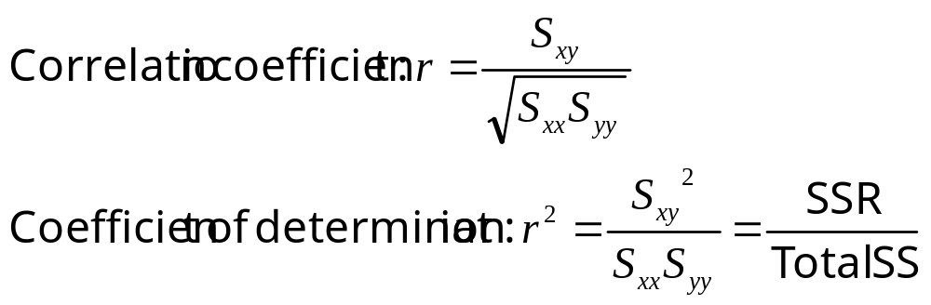
Measuring the Strength of the Relationship
If the independent variable x is of useful in predicting y, you will want to know how well the model fits.
The strength of the relationship between x and y can be measured using:

Slide 24
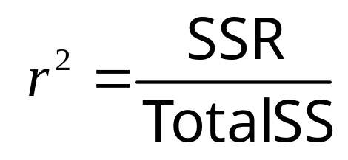
Measuring the Strength of the Relationship
Since Total SS = SSR + SSE, r² measures
the proportion of the total variation in the responses that can be explained by using the independent variable x in the model.
the percent reduction the total variation by using the regression equation rather than just using the sample mean y-bar to estimate y.
For the calculus problem, r² = .705 or 70.5%. The model is working well!

Slide 25
Interpreting a
Significant Regression
Even if you do not reject the null hypothesis that the slope of the line equals 0, it does not necessarily mean that y and x are unrelated.
Type II error—falsely declaring that the slope is 0 and that x and y are unrelated.
It may happen that y and x are perfectly related in a nonlinear way.

Slide 26
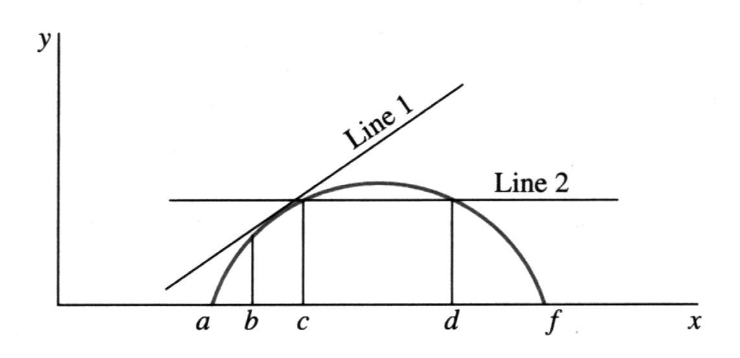
Some Cautions
You may have fit the wrong model.
Extrapolation—predicting values of y outside the range of the fitted data.
Causality—Do not conclude that x causes y. There may be an unknown variable at work!

Slide 27
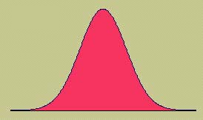
Checking the
Regression Assumptions
Remember that the results of a regression analysis are only valid when the necessary assumptions have been satisfied.
The relationship between x and y is linear, given by y = α + βx + ε.
The random error terms ε are independent and, for any value of x, have a normal distribution with mean 0 and variance σ ².

Slide 28
Diagnostic Tools
We use the same diagnostic tools used in Chapter 11 to check the normality assumption and the assumption of equal variances.
Normal probability plot of residuals
2. Plot of residuals versus fit or residuals versus variables

Slide 29
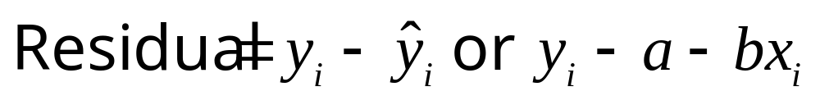
Residuals
The residual error is the “leftover” variation in each data point after the variation explained by the regression model has been removed.
If all assumptions have been met, these residuals should be normal, with mean 0 and variance σ².

Slide 30
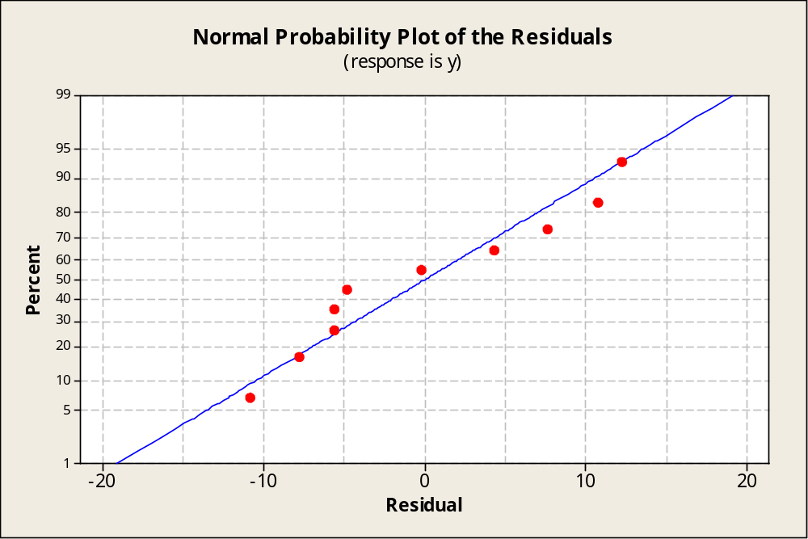
Normal Probability Plot
If the normality assumption is valid, the plot should resemble a straight line, sloping upward to the right.
If not, you will often see the pattern fail in the tails of the graph.

Slide 31
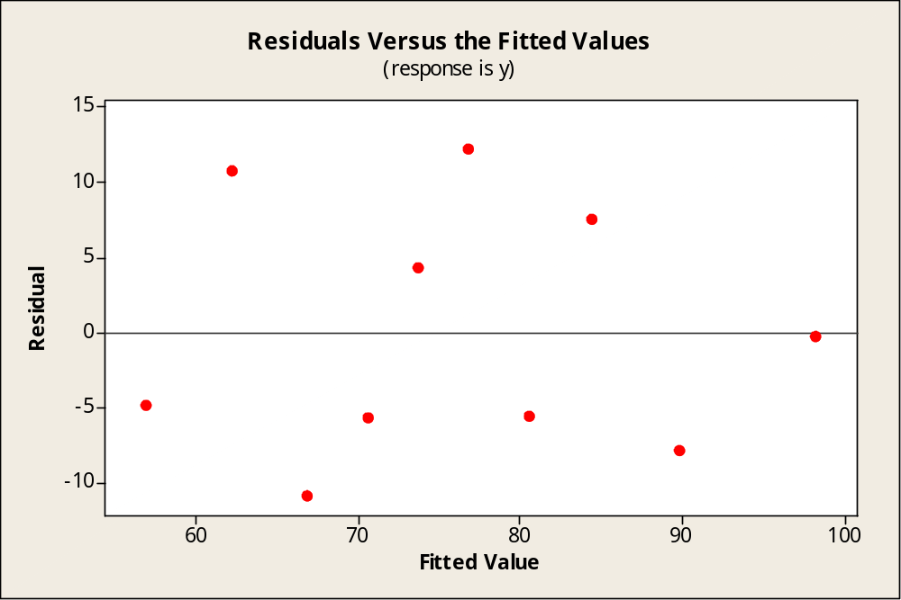
Residuals versus Fits
If the equal variance assumption is valid, the plot should appear as a random scatter around the zero center line.
If not, you will see a pattern in the residuals.

Slide 32
Estimation and Prediction
Once you have
  determined that the regression line is useful
  used the diagnostic plots to check for violation of the regression assumptions.
You are ready to use the regression line to
  Estimate the average value of y for a given value of x
  Predict a particular value of y for a given value of x.

Slide 33
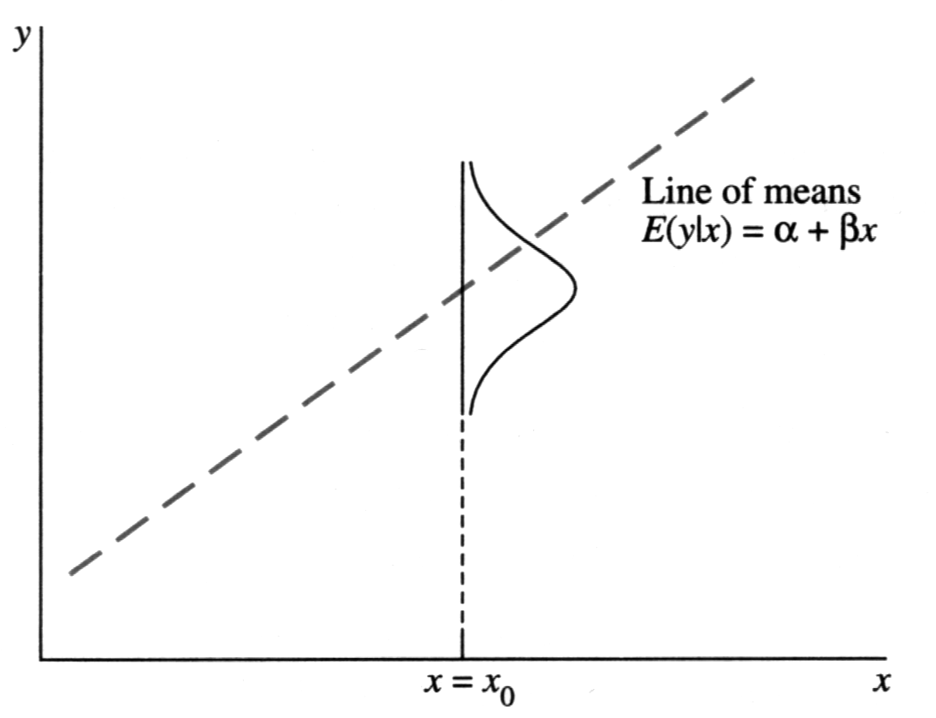
Estimation and Prediction
Estimating a particular value of y when x = x₀
Estimating the average value of y when x = x₀

Slide 34
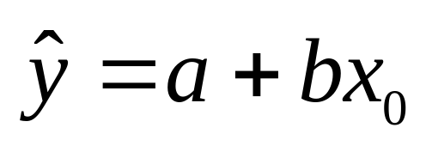
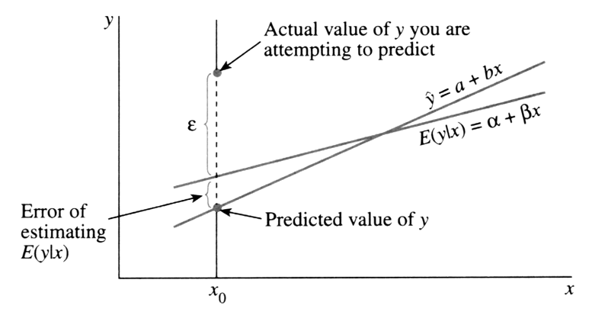
Estimation and Prediction
The best estimate of either E(y) or y for
a given value x = x₀ is
Particular values of y are more difficult to predict, requiring a wider range of values in the prediction interval.

Slide 35
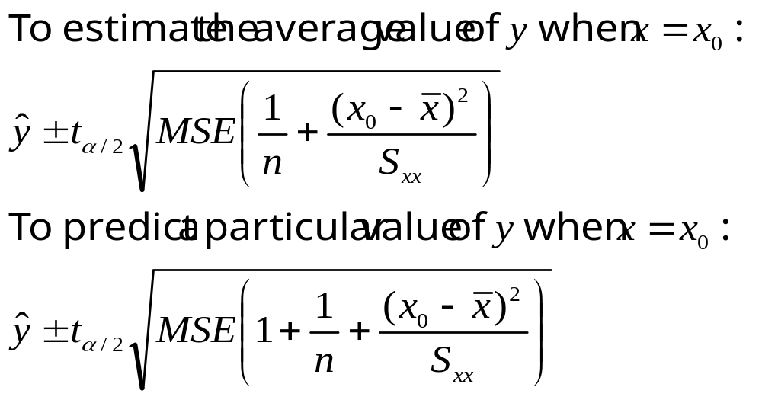
Estimation and Prediction

Slide 36
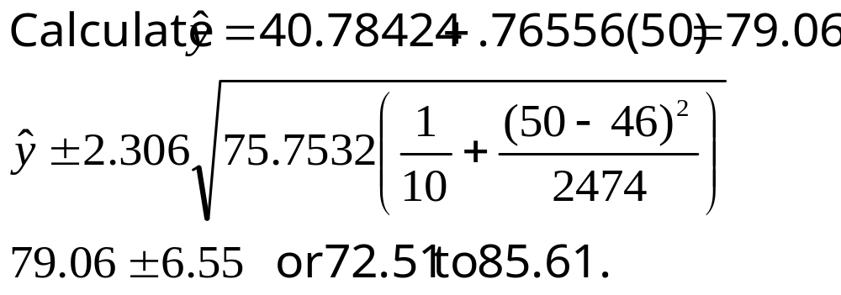
The Calculus Problem
Estimate the average calculus grade for students whose achievement score is 50 with a 95% confidence interval.

Slide 37
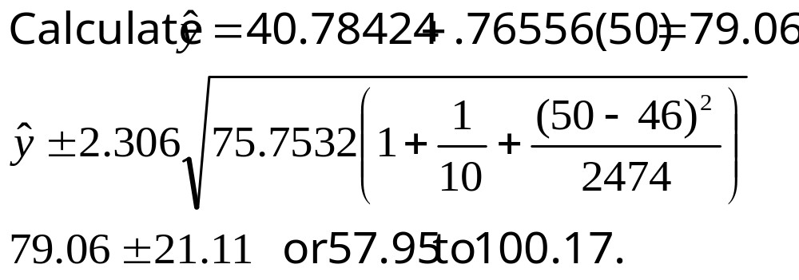
The Calculus Problem
Estimate the calculus grade for a particular student whose achievement score is 50 with a 95% confidence interval.
Notice how much wider this interval is!

Slide 38
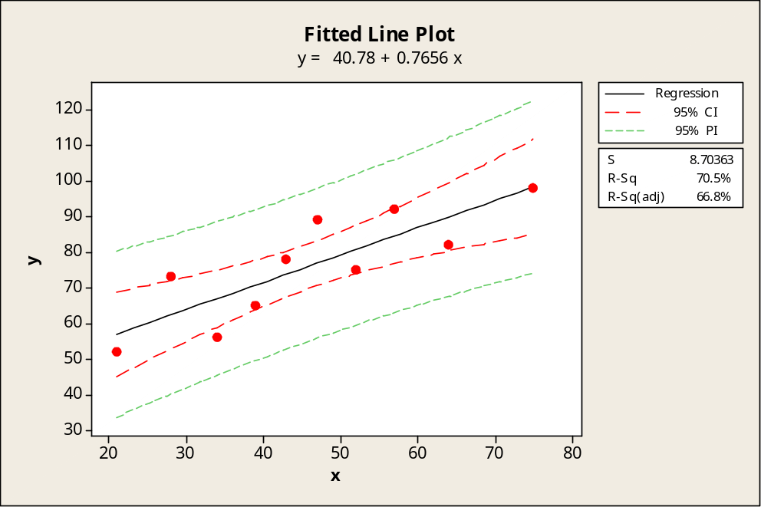
Minitab Output
Confidence and prediction intervals when x = 50
Predicted Values for New Observations
New Obs Fit SE Fit 95.0% CI 95.0% PI
1 79.06 2.84 (72.51, 85.61) (57.95,100.17)
Values of Predictors for New Observations
New Obs x
1 50.0
Green prediction bands are always wider than red confidence bands.
Both intervals are narrowest when x = x-bar.

Slide 39
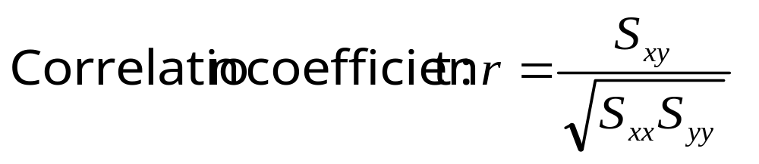
Correlation Analysis
The strength of the relationship between x and y is measured using the coefficient of correlation:
Recall from Chapter 3 that
-1 ≤ r ≤ 1 (2) r and b have the same sign
(3) r ≈ 0 means no linear relationship
(4) r ≈ 1 or –1 means a strong (+) or (-) relationship

Slide 40

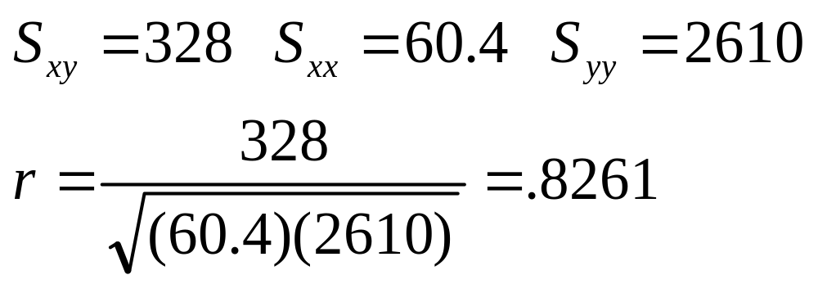
Example
The table shows the heights and weights of
n = 10 randomly selected college football players.
Player | 1 | 2 | 3 | 4 | 5 | 6 | 7 | 8 | 9 | 10
Height, x | 73 | 71 | 75 | 72 | 72 | 75 | 67 | 69 | 71 | 69
Weight, y | 185 | 175 | 200 | 210 | 190 | 195 | 150 | 170 | 180 | 175
Use your calculator to find the sums and sums of squares.

Slide 41
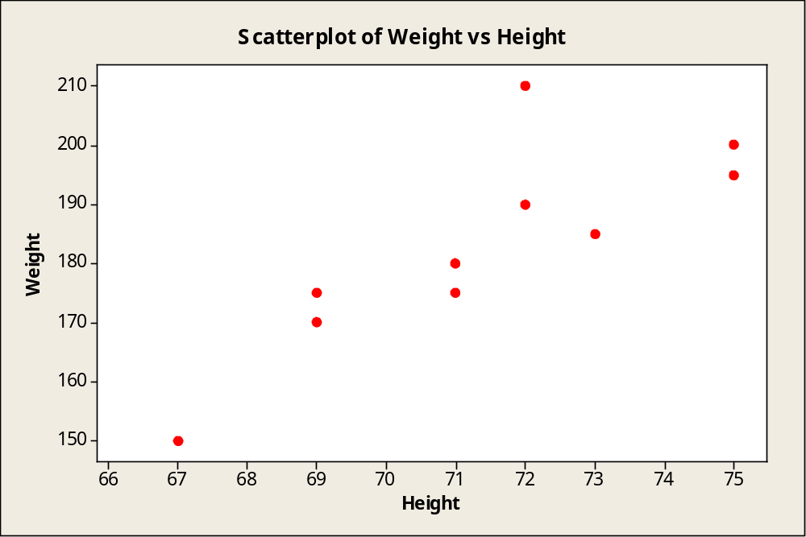
Football Players
r = .8261
Strong positive correlation
As the player’s height increases, so does his weight.

Slide 42
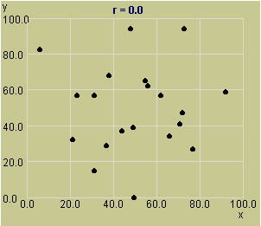
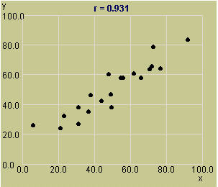
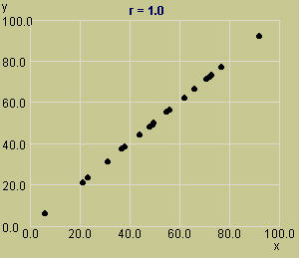
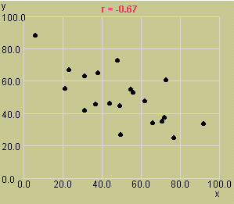
Some Correlation Patterns
Use the Exploring Correlation applet to explore some correlation patterns:
r = 0; No correlation
r = .931; Strong positive correlation
r = 1; Linear relationship
r = -.67; Weaker negative correlation
MY
APPLET

Slide 43
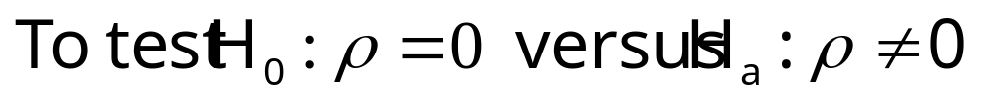
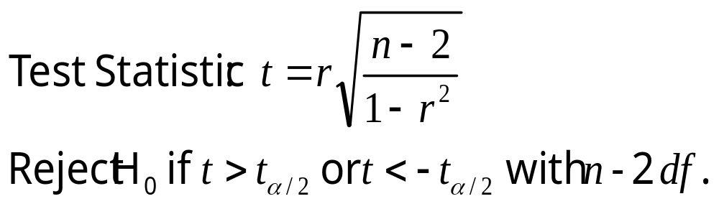
Inference using r
The population coefficient of correlation is called ρ (“rho”). We can test for a significant correlation between x and y using a t test:
This test is exactly equivalent to the t-test for the slope β=0.

Slide 44
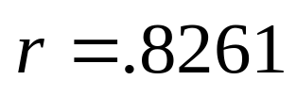
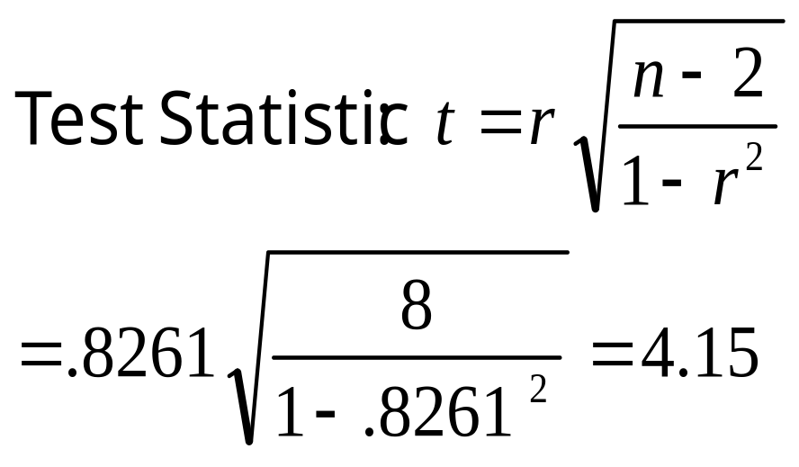
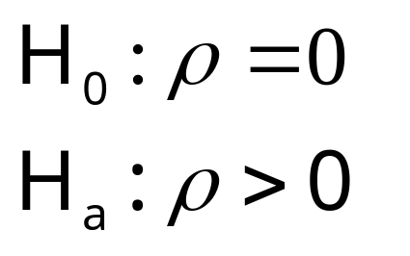
Example
Is there a significant positive correlation between weight and height in the population of all college football players?
Use the t-table with n-2 = 8 df to bound the p-value as p-value < .005. There is a significant positive correlation.
MY
APPLET

Slide 45
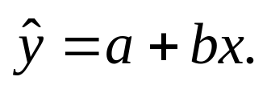
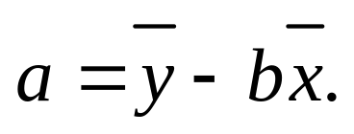
Key Concepts
I. A Linear Probabilistic Model
1. When the data exhibit a linear relationship, the appropriate model is y = α + β x + ε .
2. The random error ε has a normal distribution with mean 0 and variance σ².
II. Method of Least Squares
1. Estimates a and b, for α and β, are chosen to minimize SSE, the sum of the squared deviations about the regression line,
2. The least squares estimates are b = S_{xy}/S_{xx} and

Slide 46

Key Concepts
III. Analysis of Variance
1. Total SS = SSR + SSE, where Total SS = S_{yy} and
SSR = (S_{xy})² / S_{xx}.
2. The best estimate of σ ² is MSE = SSE / (n − 2).
IV. Testing, Estimation, and Prediction
1. A test for the significance of the linear regression—H₀ : β = 0 can be implemented using one of two test statistics:

Slide 47

Key Concepts
2. The strength of the relationship between x and y can be measured using
which gets closer to 1 as the relationship gets stronger.
3. Use residual plots to check for nonnormality, inequality of variances, and an incorrectly fit model.
4. Confidence intervals can be constructed to estimate the intercept α and slope β of the regression line and to estimate the average value of y, E( y ), for a given value of x.
5. Prediction intervals can be constructed to predict a particular observation, y, for a given value of x. For a given x, prediction intervals are always wider than confidence intervals.

Slide 48

Key Concepts
V. Correlation Analysis
1. Use the correlation coefficient to measure the relationship between x and y when both variables are random:
2. The sign of r indicates the direction of the relationship; r near 0 indicates no linear relationship, and r near 1 or −1 indicates a strong linear relationship.
3. A test of the significance of the correlation coefficient is identical to the test of the slope β.

